Slide 1
Graphics Hardware
Presented by
Tanim Ahmed
Lecturer,Diu,CSE

Slide 2
Graphics System
Typical graphical system consists of host computer with support of fast processor, large memory, frame buffer and
Hardwares
Input Devices
Output Devices
Softwares

Slide 3
Input Devices
Most systems have a keyboard and one or more additional devices specially designed for interactive input. This includes:
Touch Panels
Light Pens
Graphics Tablets
Micro-Phone
Film Recorder
Mouse
Joysticks
Data Gloves

Slide 4
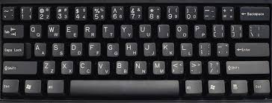
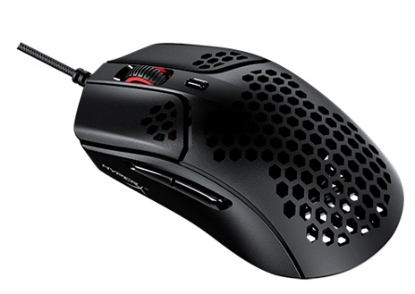

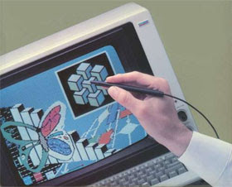
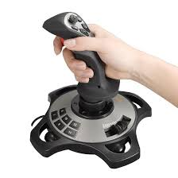
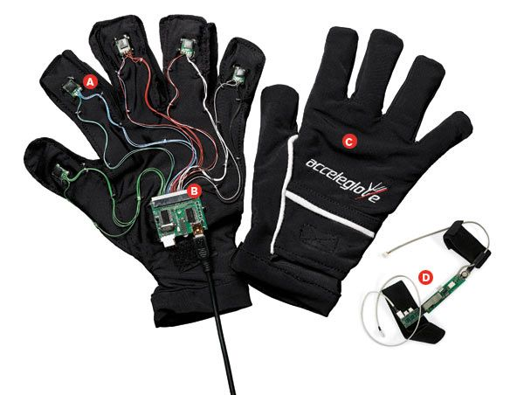
Input Devices

Slide 5
Output Devices
Computer Graphics can use many different output devices or display devices:
Cathode Ray Tube (CRT)
Vector/Random Scan Display
Raster Scan Display
Colored Monitors
LED, LCD, TFT Screens

Slide 6
The Cathode Ray Tubes (CRTs)
Most common display device today
Characterized by:
Evacuated glass bottle
Extremely high voltage
Heating element (filament)
Electrons pulled towards anode focusing cylinder
Vertical and horizontal deflection plates
Beam that strikes phosphor coating on front of tube

Slide 7
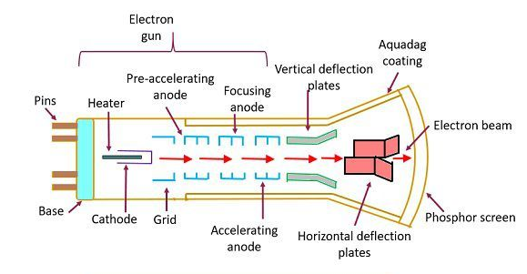
The Cathode Ray Tubes (CRTs)

Slide 8
How CRT works
It converts electrical signal (voltage, current) to visual signal.
The electron gun contains a filament that, when heated, emits a stream of electrons.
Electrons are focused with an electromagnet into a sharp beam and directed to a specific point of the face of the picture tube
The front surface of the picture tube is coated with small phospher dots
When the beam hits a phospher dot it glows with a brightness proportional to the strength of the beam and how long it is hit

Slide 9
How CRT works(cont.)
In a CRT the focusing system acts like a light lens with a focal length such that the center of focus is the screen.
The horizontal and vertical deflectors allow the electron beam to be focused on any spot on the screen.
The screen is coated with a special organic compound called a phosphor.
For color systems there are groups of three different phosphors, one to produce red shades, one for green shades, and one for blue shades.

Slide 10
How CRT works(cont.)
Electrons hit the screen phosphor molecules and cause a ground state to singlet excited state transition.
Most of the phosphors relax back to the ground state by emitting a photon of light which is called fluorescence.
This happens very rapidly so that all of the molecules which fluoresce do so in under a millisecond.
These phosphors then emit light, called phosphorescence, that decays slower but still rapidly (in about 15-20 milliseconds)
so there is the need to refresh the screen by redrawing the image.

Slide 11
Phosphor
Phosphors – terms…
Flourescence: Light emitted while the phosphor is being struck by electrons
Phosphorescence: Light emitted once the electron beam is removed
Persistence: The time from the removal of the excitation to the moment when phospherescence has decayed to 10% of the initial light output
High persistence phosphors allow for a lower refresh rate, avoids flickers
Low persistence phosphors require a high refresh rate to prevent flicker.

Slide 12
CRTs - Display Technologies
Two main types:
Vector/Random Display
Raster Display

Slide 13
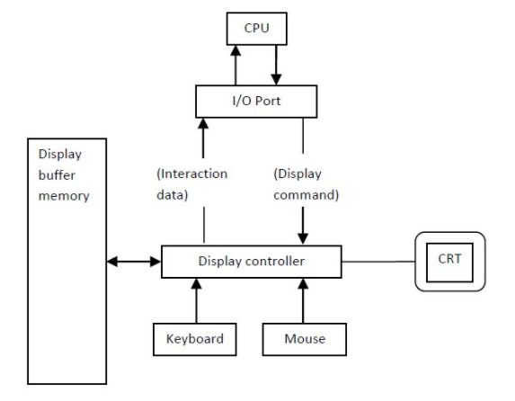
Vector Displays

Slide 14
Vector Displays
The architecture of vector display consists of display controller, CPU, display buffer memory and CRT.
Display controller is connected as an I/O peripheral to the CPU.
Display buffer stores computer produced display list or display program.
The Program contains point & line plotting commands with end point co-ordinates as well as character plotting commands.
Display controller interprets command and sends digital and point co-ordinates to a vector generator.

Slide 15
Vector Displays
Vector generator then converts the digital co-ordinate value to analog voltages for beam deflection circuits that displace an electron beam which points on the CRT’s screen.
As beam is deflected from end point to end point hence this techniques is also called random scan.
We know as beam strikes phosphors coated screen it emits light but that light decays after few milliseconds and therefore it is necessary to repeat through the display list to refresh the screen at least 30 times per second to avoid flicker.
As display buffer is used to store display list and used to refreshing, it is also called refresh buffer.

Slide 16
Vector Displays
If we want line between point p1 & p2 then we directly drive the beam deflection circuitry which focus beam directly from point p1 to p2
If we do not want to display line from p1 to p2 and just move then we can blank the beam as we move it.
To move the beam across the CRT, the information about both magnitude and direction is required. This information is generated with the help of vector graphics generator.

Slide 17
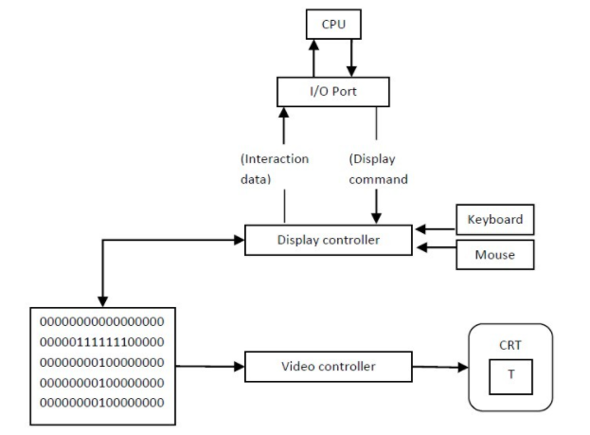
Raster Displays

Slide 18
Raster Displays
The architecture of Raster display. It consists of a display controller, CPU, video controller, refreshes buffer, keyboard, mouse, and CRT.
The display image is stored in the form of 1’s and 0’s in the refresh buffer.
The video controller reads this refresh buffer and produces the actual image on screen.
It will scan one line at a time from top to bottom & then back to the top.

Slide 19
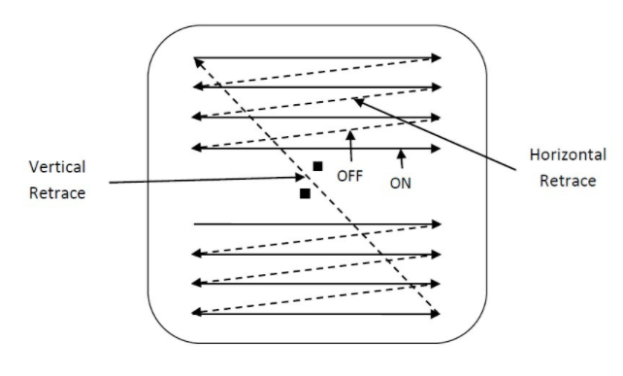
Raster Displays

Slide 20
Raster Displays
The horizontal and vertical deflection signals are generated to move the beam all over the screen in a pattern shown in Image.
Here beam is swept back & forth from left to the right.
When beam is moved from left to right it is ON.
When beam is moved from right to left it is OFF
The process of moving beam from right to left after completion of row is known as Horizontal Retrace.
When beam is reach at the bottom of the screen. It is made OFF and rapidly retraced back to the top left to start again and process of moving back to top is known as Vertical Retrace.

Slide 21
Raster Displays
The screen image is maintained by repeatedly scanning the same image by refreshing of Screen.
Frame Buffer is a special area of memory is dedicated to graphics. It holds set of intensity values for all the screen points
That intensity is retrieved from frame buffer and display on screen one row at a time.
Each screen point referred as pixel or Pel (Picture Element).
Each pixel can be specified by its row and column Numbers.

Slide 22
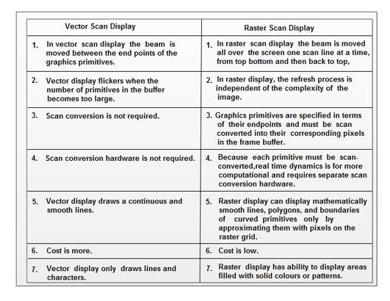
Vector vs Raster Displays

Slide 23
Color CRT Monitors
Displays color pictures by using combination of phosphors that emit different colored light.
Two techniques for producing color displays on CRT:
Beam Penetration Method
Shadow Mask Method

Slide 24
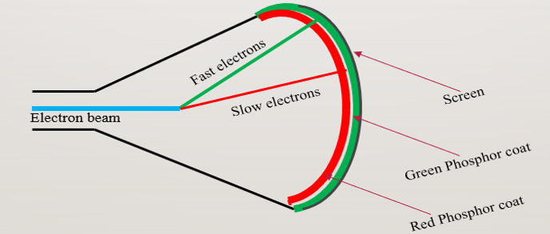
Beam Penetration Method
Used with random scan monitors
The screen has two layers of phosphor: usually red and green
Color depends on how far the electron beam penetrates through the two layers

Slide 25
Beam Penetration Method(cont.)
The speed of electrons – beam acceleration voltage.
Slow Electrons Red color
Fast Electrons Green color
Intermediate Speed Electrons Yellow and orange colors
Quality of Picture is not so good and is inexpensive.
Can display only four colors.

Slide 26
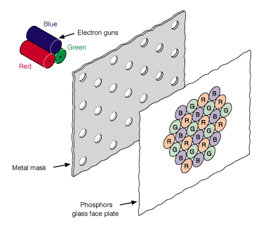
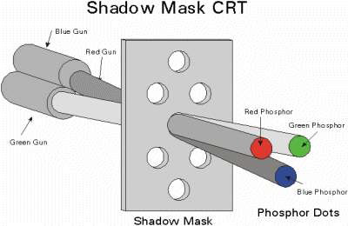
Shadow-Mask Method
Color CRTs have
Three electron guns
A metal shadow mask to differentiate the beams

Slide 27
Shadow-Mask Method
Uses Red, green and Blue-in suitable proportions to get a combination of colors
Three electron gun placed one by the side of the other to form a triangle or a “Delta”
Each pixel point on the screen is also made up of 3 types of phosphors to produce red, blue and green colors.
Before the phosphor screen is a metal screen, called a “shadow mask”.
The 3 electron beams are deflected and focused as a group onto the shadow mask, which contains a series of holes aligned with the phosphor-dot patterns.
The 3 beams pass through a hole in the shadow mask and activate a dot triangle, which appears as a small color spot on the screen.

Slide 28
Reference
Computer Graphics
Donald Hearn, M Pauline Baker
Pearson Education

